Slide 1

Armed Forces College of Medicine
AFCM

Slide 2
Noninvasive & invasive cardiac investigations
Prepared by
Ahmed Magdy Mostafa, MD
Lecturer of Cardiology, AFCM

Slide 3
ILOs
By the end of this lecture, the candidate will be able to :
Enumerate the different cardiac investigations.
Demonstrate the indications, contraindications, values and limitations of most commonly used non -invasive and invasive cardiac investigations .

Slide 4
Cardiovascular investigations
ECG
Stress ECG
Transthoracic echocardiography (TTE)
Dobutamine stress ECHO
Transesophageal echocardiography (TOE)
Myocardial perfusion imaging (MPI)
CT angiography (CTA) / coronarography (CTC)
Cardicac MRI (CMRI)
Invasive coronary angiography (ICA) / peripheral angiography
Invasive hemodynamic measurement

Slide 5
ECG
Will be discussed in details in separate lectures.

Slide 6
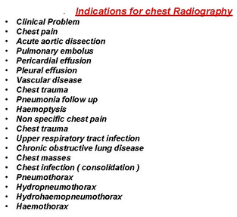
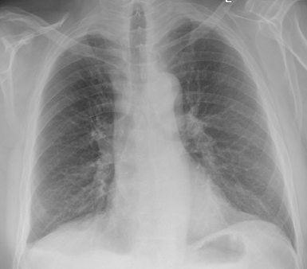
Chest X-ray

Slide 7
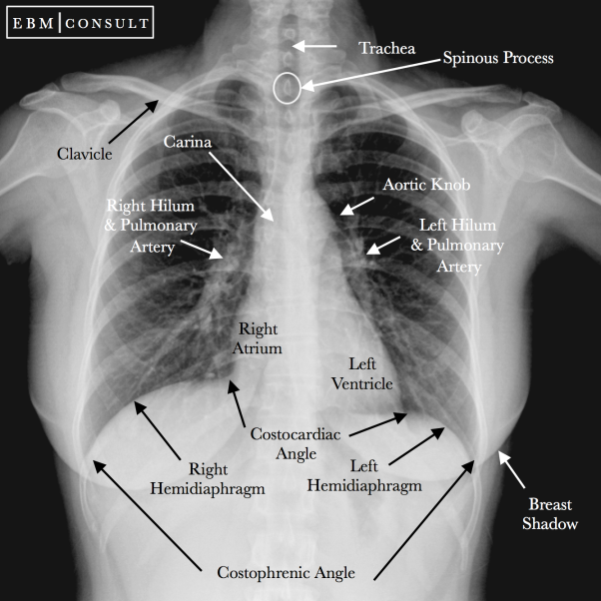
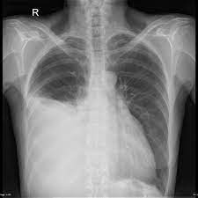
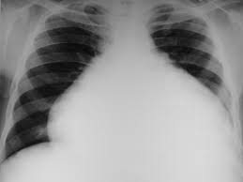
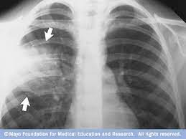
Normal
Pleural effusion
Pericardial effusion
pneumonia

Slide 8
General principles of stress tests
Ischemia testing
Functional capacity assessment
Viability testing
Before the test:
Assess the pretest probability
Know sensitivity and specificity
Are there therapeutic consequences?

Slide 9
Stress ECG
Pros: Cheap, available, fast, non-invasive
Cons: low sensitivity, many non-diagnostic findings, does not localize ischemia
Aim: adequate workload (W/kg, age dependent), at least submaximal heart rate 0.8x(220-age)
Ischemia = horizonatl or descending ST-depressions at least 1mm in two leads
Abnormal: hypertensive hyperreaction > 250/115 mmHg, drop in blood pressure, nsVT, new Afib, claudications, chest pain, dyspnea

Slide 10
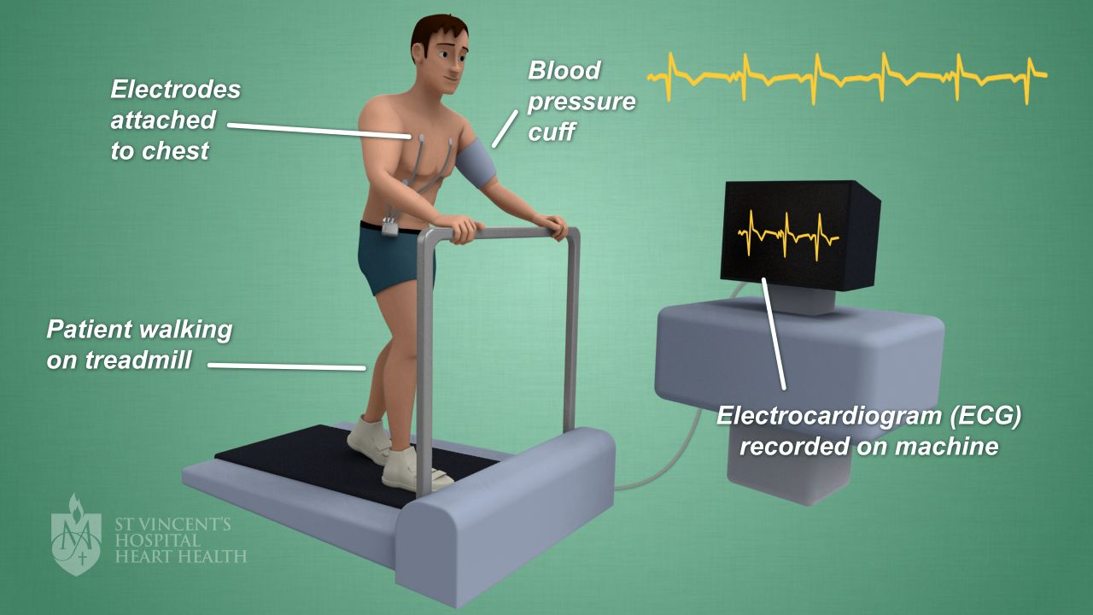

Slide 11
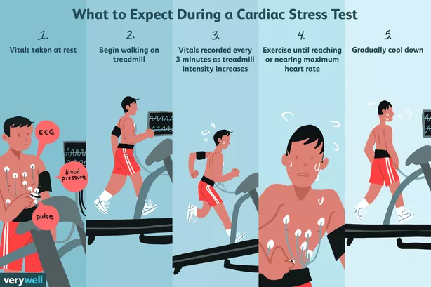
Stress ECG

Slide 12
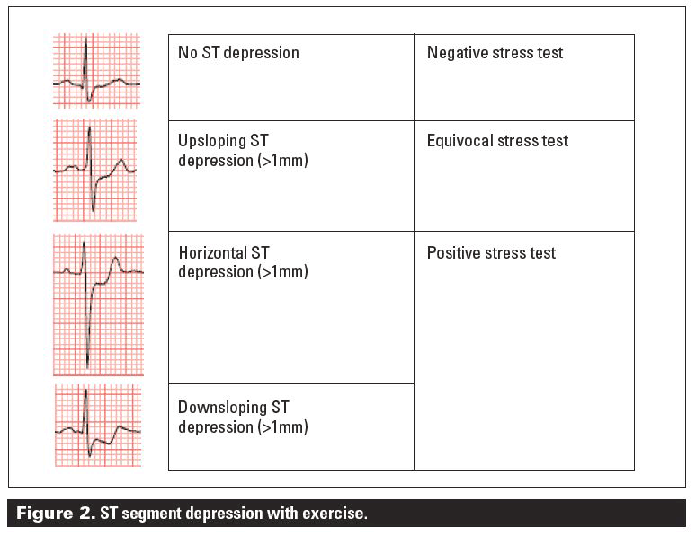

Slide 13
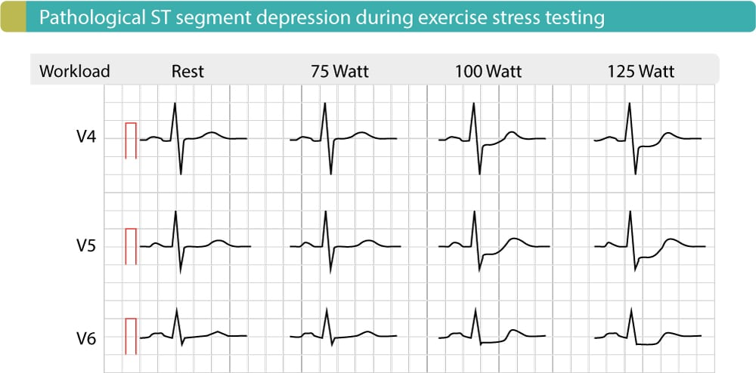

Slide 14
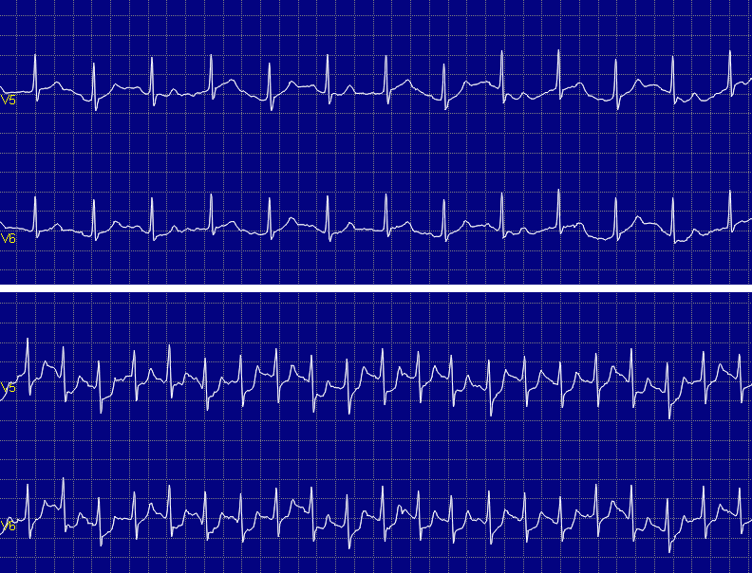
Positive stress ECG

Slide 15
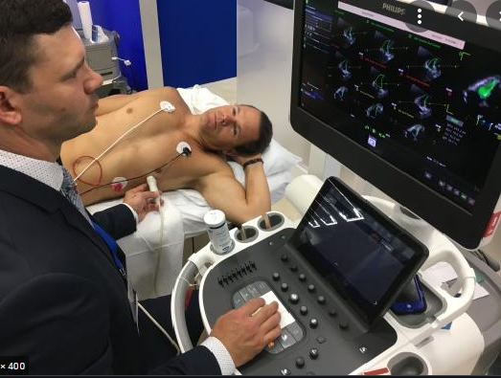
Transthorathic Echocardiography

Slide 16
TTE
Transthoracic echocardiography is an examination with not known side effects, has a widespread availability, represents a low-cost high-effective approach and can be used in a large variety of clinical questions.
However, even if the possibility of becoming a wide range screening method exists, echocardiography examinations should be rationalized to meet criteria of incremental clinical value.

Slide 17
indications
– Symptoms potentially due to suspected cardiac etiology. – Assessment of known or suspected adult congenital heart dis. – Assessment of CAD and its mechanical complications. – Evaluation of valvular & structural heart disease. – Initial evaluation of prosthetic valve for establishment of baseline
after placement. – Initial evaluation of suspected infective endocarditis. – Evaluation of cardiac mass (suspected tumor or thrombus). – Evaluation of pericardial conditions: i.e. pericardial effusion,
constrictive pericarditis. – Initial evaluation of known or suspected cardiomyopathy.

Slide 18
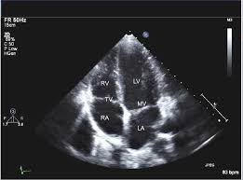
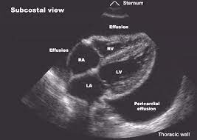
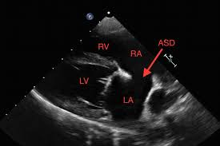
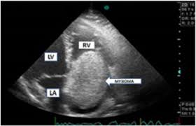
Normal

Slide 19
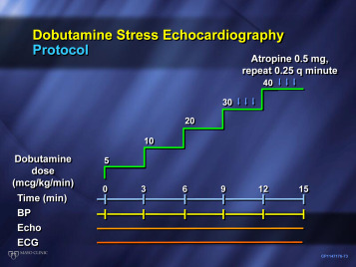

Slide 20
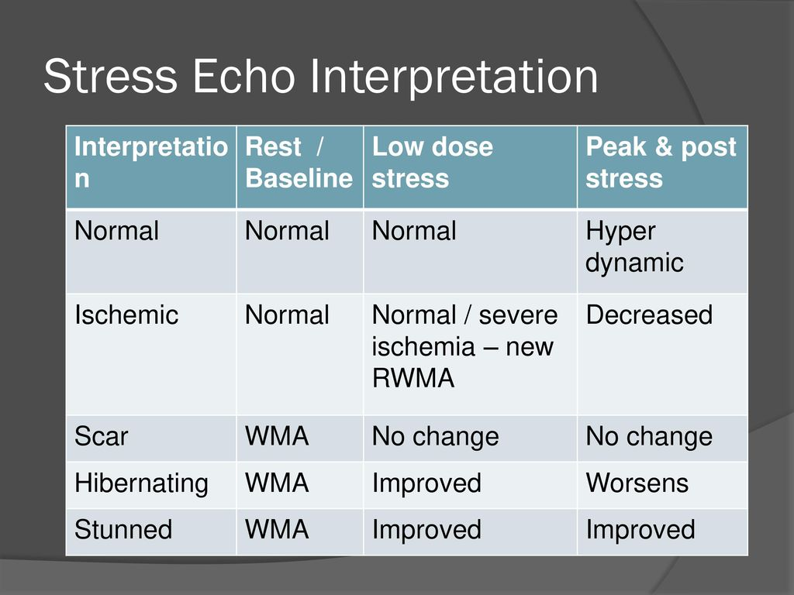
Stress ECHO
Ischemia testing = new wall motion abnormality
Viability testing = contraction of previously akinetic segment, increase of LVEF
Low-flow low-gradient aortic stenosis = increase of LVEF and gradient on AV

Slide 21
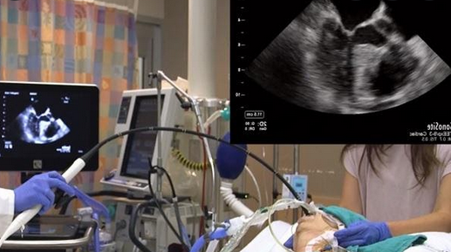
Transesophageal ECHO

Slide 22
Indications
Evaluation of suspected acute aortic pathology including dissection.
To determine mechanism of regurgitation and determine suitability of valve repair.
To diagnose/manage endocarditis
Persistent fever in patient with intracardiac device.
Evaluation of patient with atrial fibrillation/flutter to facilitate clinical decision-making with regards to anticoagulation and/or cardioversion and/or radiofrequency ablation.

Slide 23
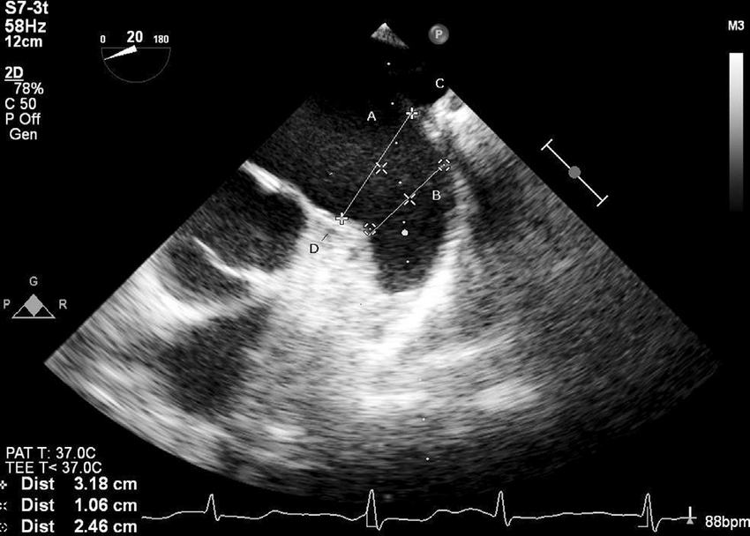
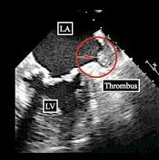
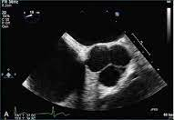
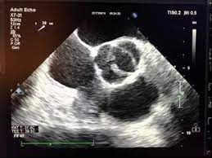

Slide 24
SPECT
I.V. Radioactive agent (Tc-MIBI, thallium) that binds to membranes in cardiocytes
Measurement of relative LV perfusion
Pros: Quantification and localization of ischemia, good specificity, viability
Cons: Intermediate sensitivity, high radiation dose

Slide 25
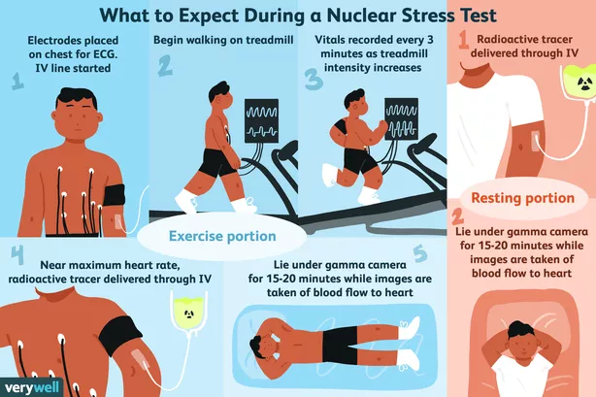

Slide 26
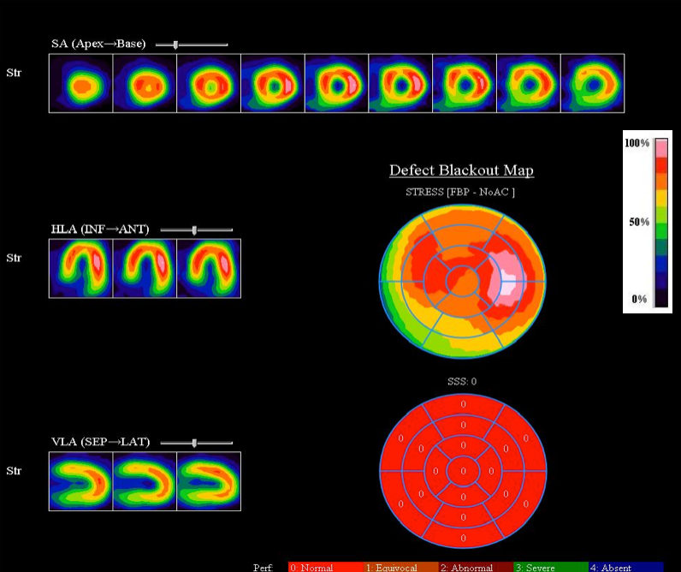

Slide 27
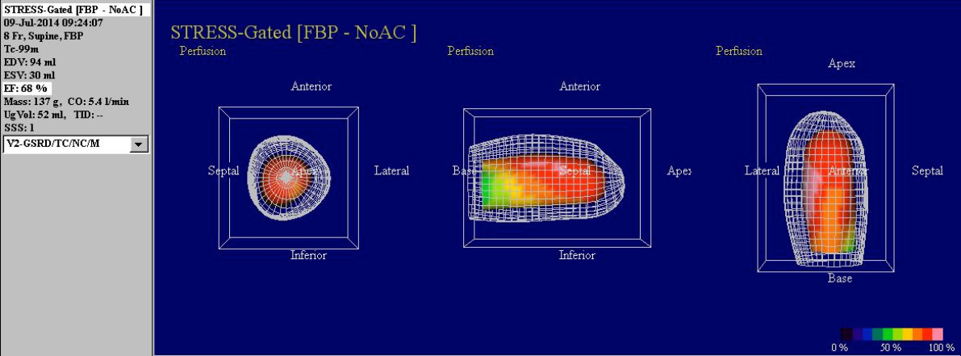
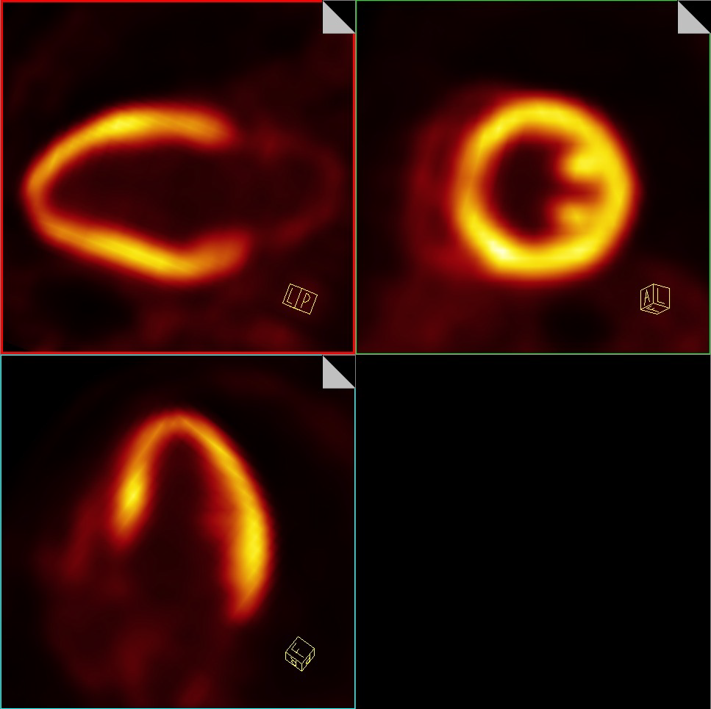

Slide 28
CT-coronarography
I.V. iodine contrast agent, beta-blocker to slow HR and nitroglycerine do dilatate coronary arteries, prospective ECG gating during end-diastole
Pros: superb sensitivity, fast, additional anatomic information (coronary anomalies, heart chambers, valves, aortic root, lungs, pulmonary artery), calcium score
Cons: poor performance in Afib, requires very good CT and expert reader
Additional (experimental) modalities: perfusion CT, CT-FFR

Slide 29
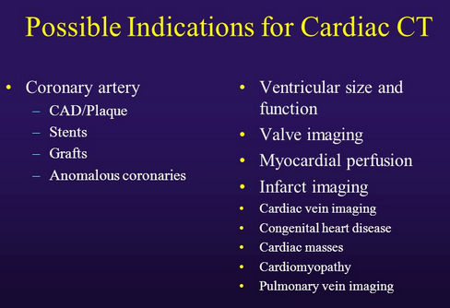
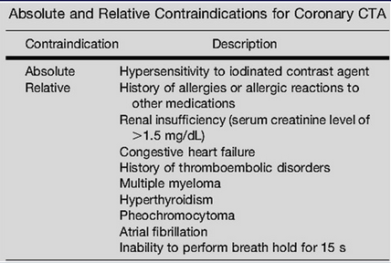
Indications & contraindications

Slide 30
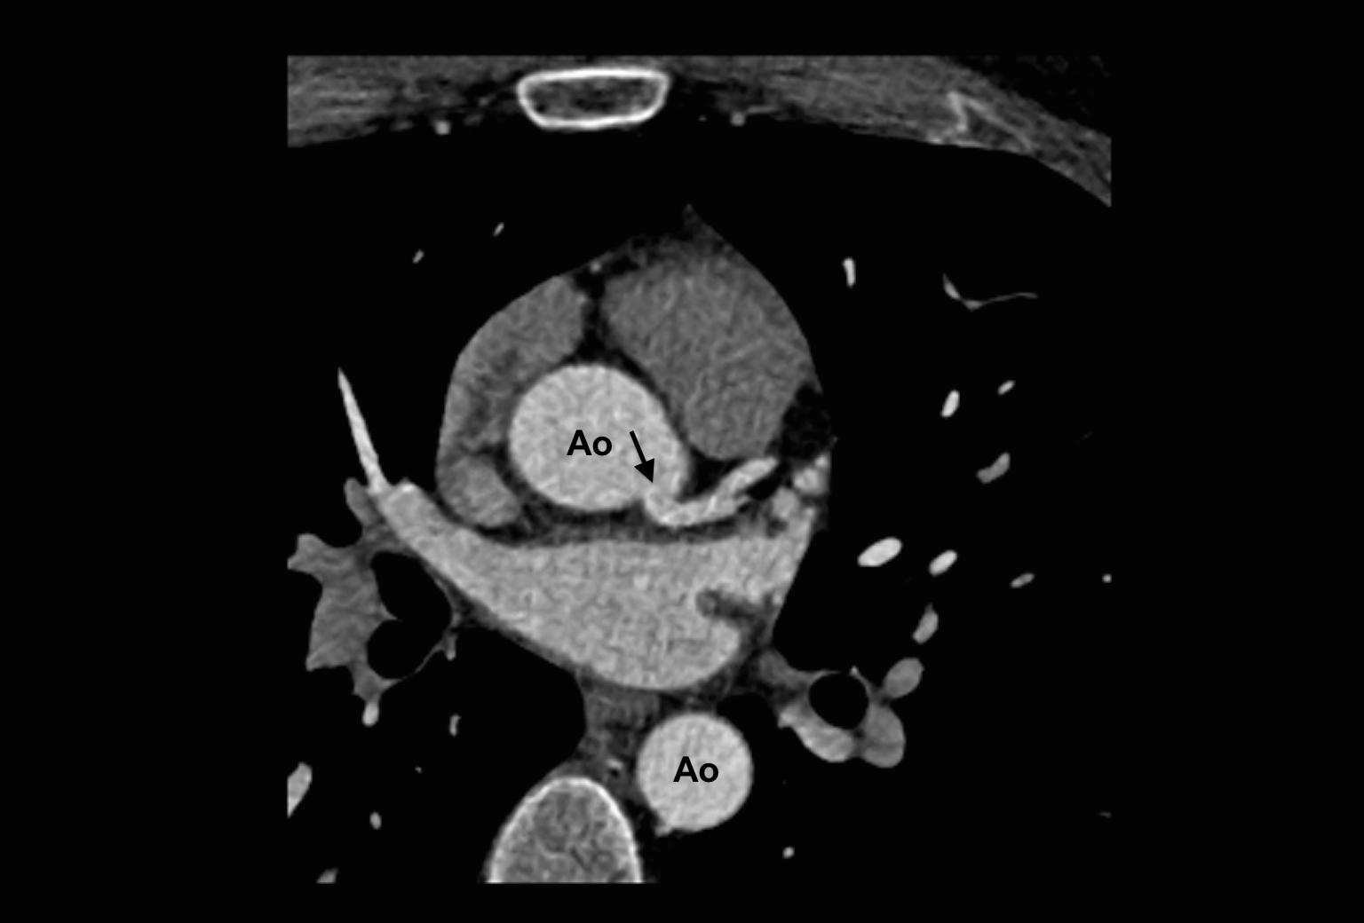
CTC

Slide 31
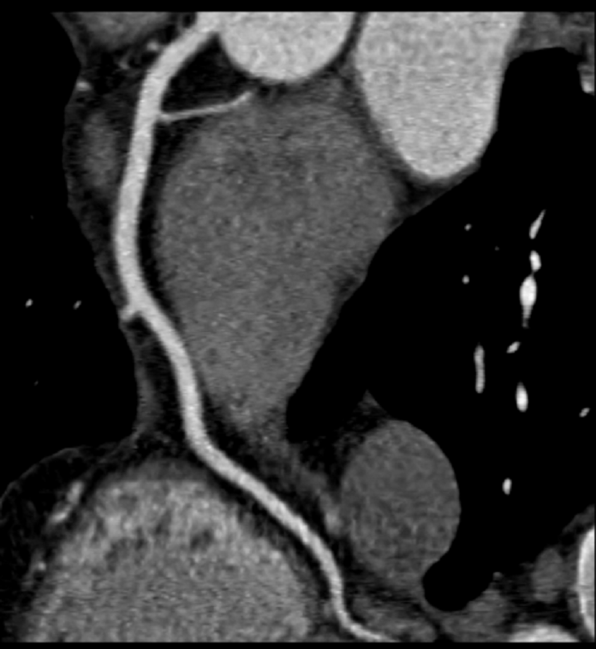
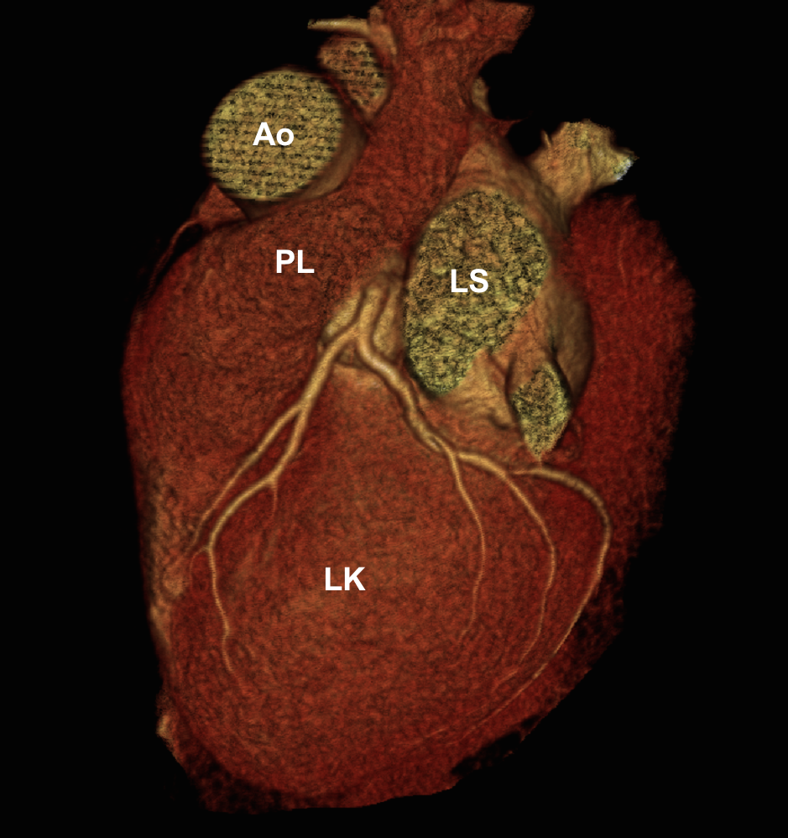
CTC

Slide 32
Cardiac MRI
I.V. Gadolinium contrast agent, prospective imaging planes
Pros: best for myocardial diseases, LV and RV volumes, masses, function and viability testing and for congenital heart diseases
Cons: Expensive, time consuming, expet reader, perfusion and stress wall motion MRI are rarely available, does not show coronary arteries

Slide 33
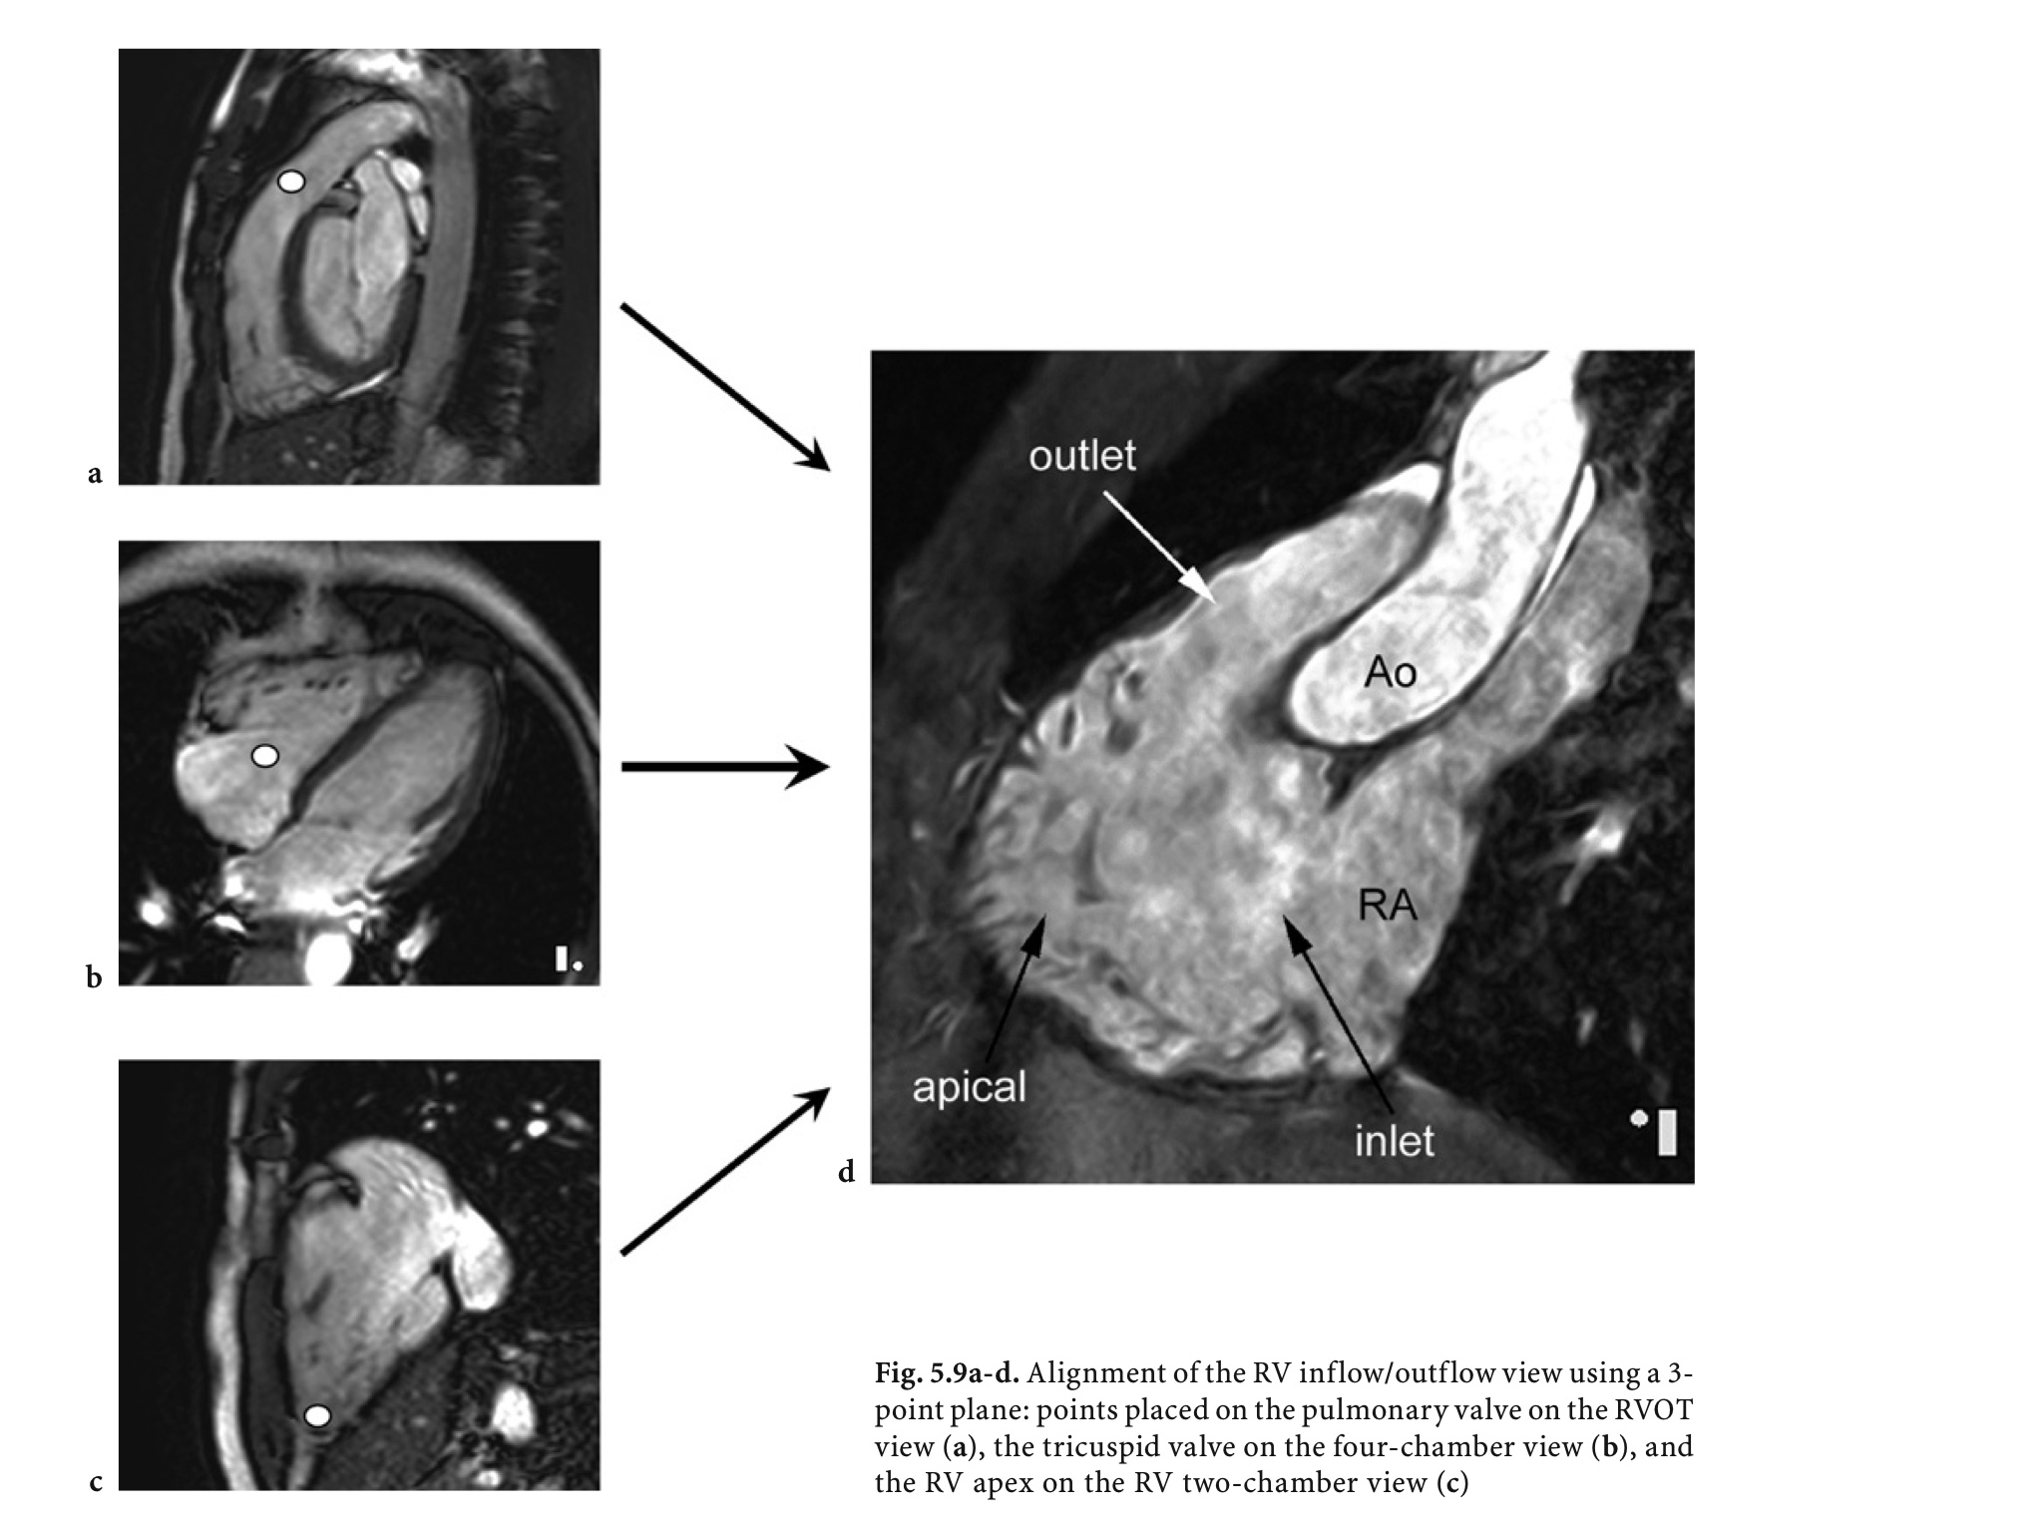

Slide 34
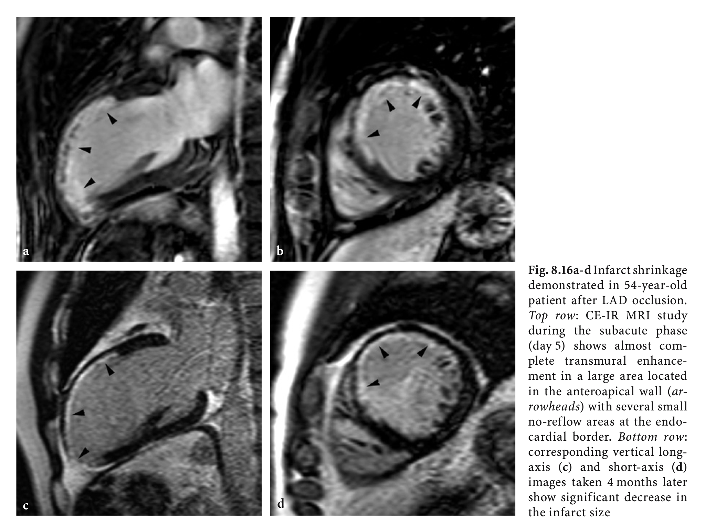

Slide 35
Coronary angiography
Access site via radial, femoral or brachial artery with seldinger technique (needle, wire, sheath).
Selective engagement of left and right coronary ostia with performed shaped catheter (4-6F = 1,33-2mm)
In selected cases ventriculography and aortography with pigtail catheter
Pros: Golden standard for coronary stenosis assessment, additional intravascular imaging and preassure measurement (IVUS, OCT, NIRS, FFR), direct PCI
Cons: Expensive, bleeding and contrast nephropathy

Slide 36
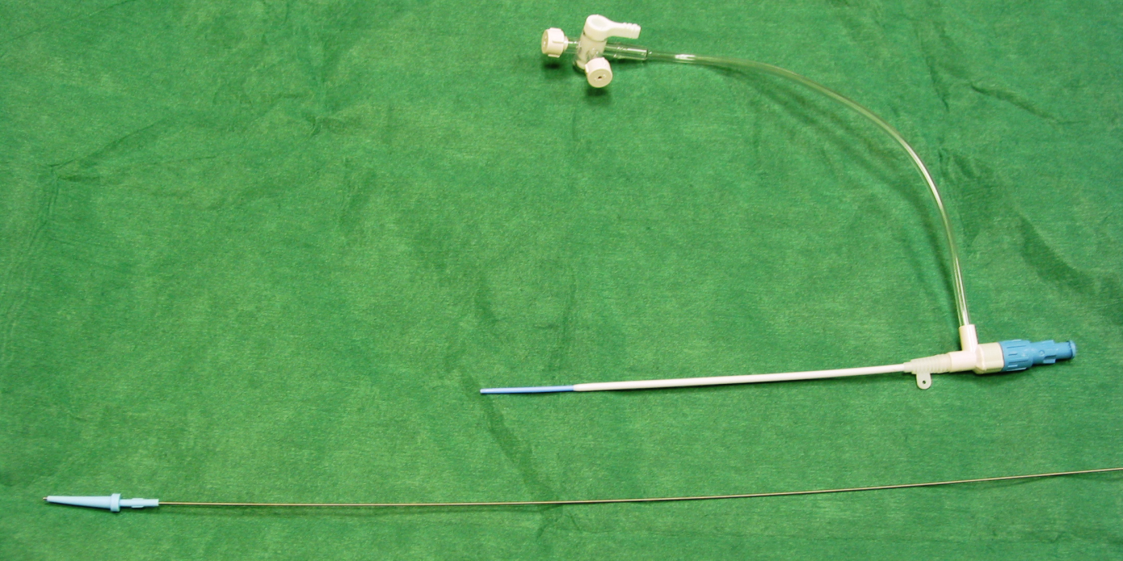
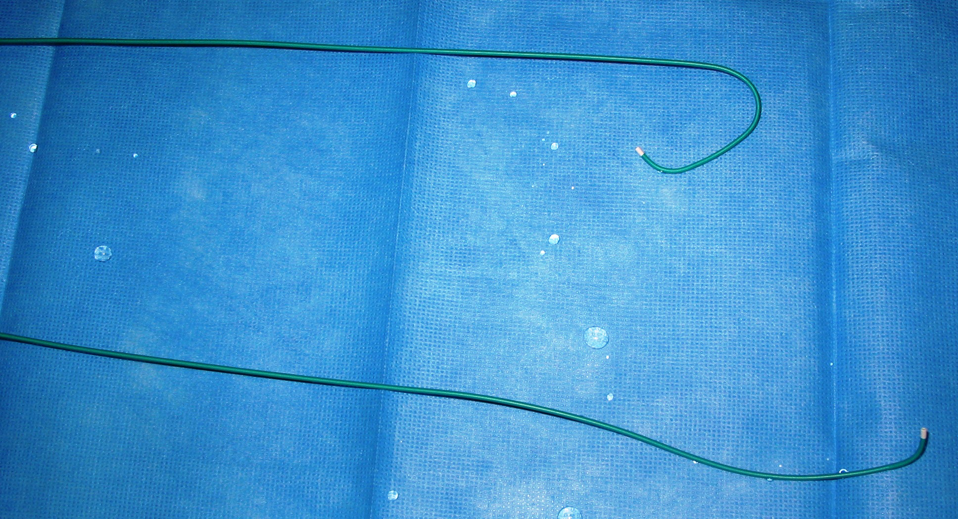
ICA

Slide 37
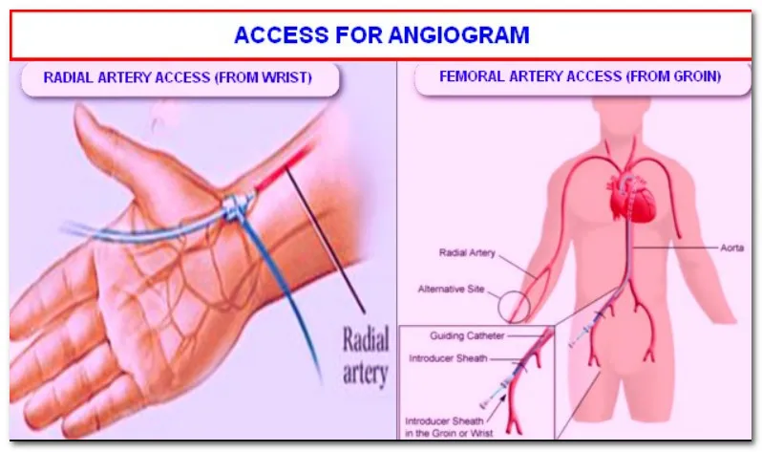

Slide 38
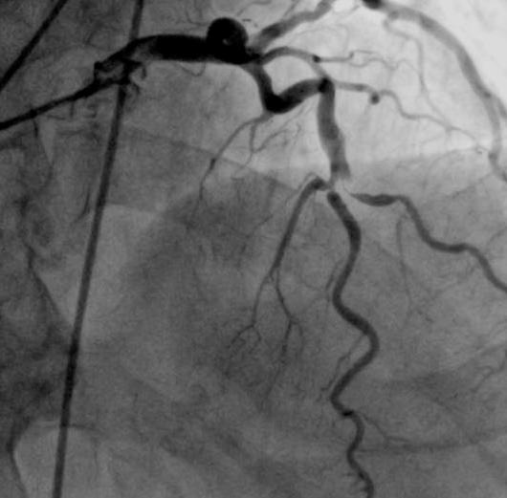
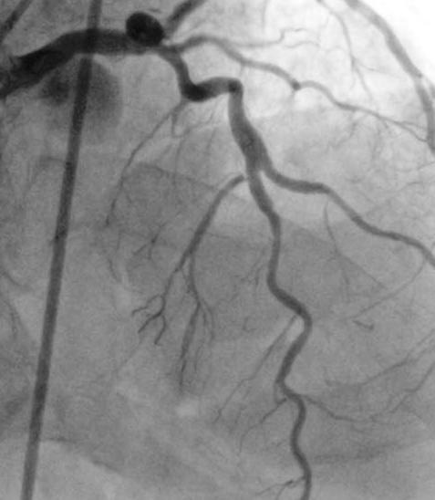
ICA

Slide 39
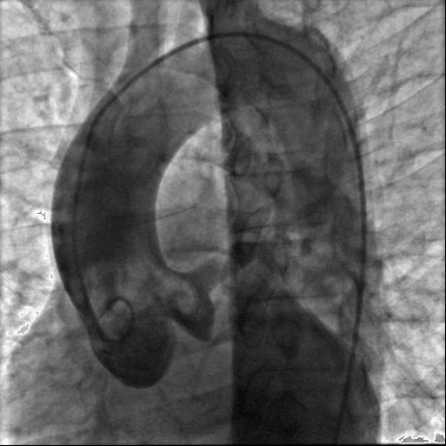
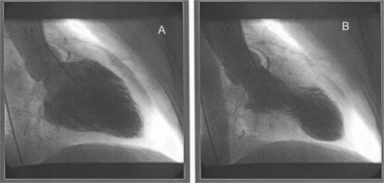
Aortography and ventriculography

Slide 40
Hemodynamic measurement
Direct invasive measurement of pressures and saturation and assessment of cardiac output with thermodilution or O2 consuption (Fick)
CVP – RA – RV – PA- PCWP (right side)
Aorta – LV (left side)
CO/CI
Calculated: TPG, diastolic pulmonary gradient, PVR/PVRI, SVR/SVRI

Slide 41
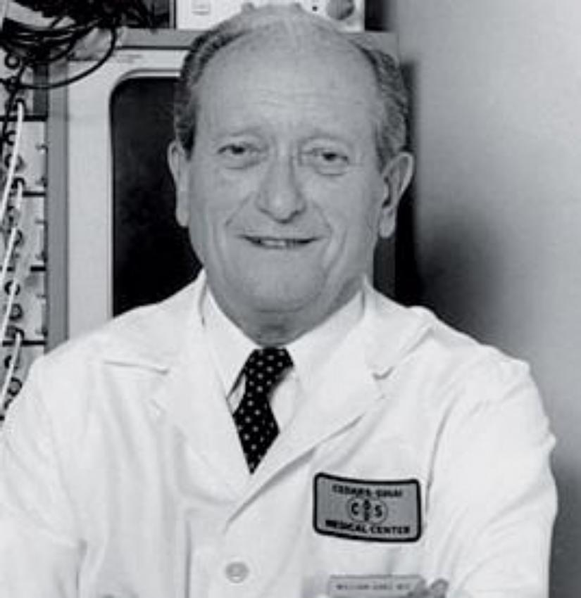
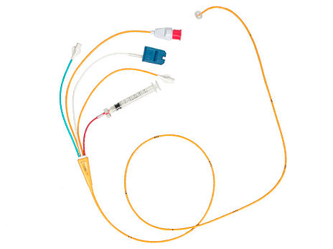
Hemodynamic measurement
Vilém Ganz 1919-2009, Czech cardiologist and the co-inventor of the Swan-Ganz catheter.
Swan-Ganz catheter

Slide 42
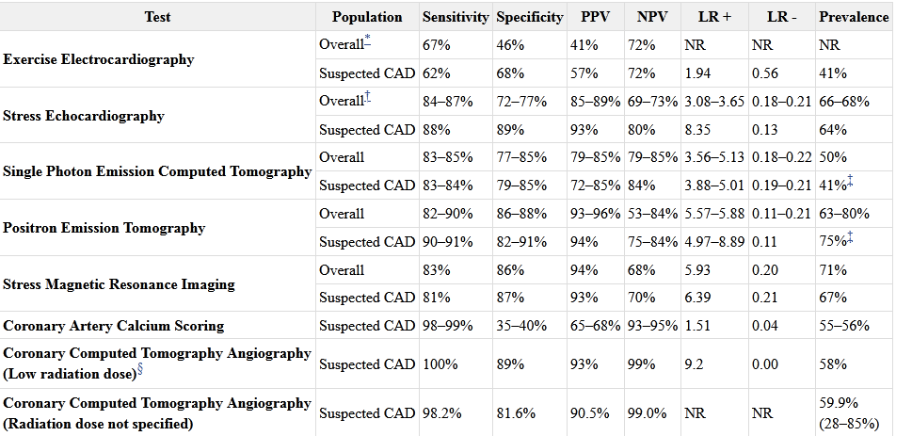

Slide 43
Quiz 1
Which of the following is the best cardiac investigation to diagnose atrial fibrillation is ?
ECG
ECHO
Cardiac MRI
CT coronary Angio.
Answer: 1

Slide 44
Quiz 2
70 y. old male who is hypertensive , complaining of recent attacks of dyspnea on minimal exertion associated with dizziness. Ejection systolic murmur is heard during cardiac auscultation.
What is the next step in diagnosis?
Stress ECG
ECHO
Invasive coronary angio.
Cardiac MRI
Answer: 2

Slide 45
Quiz 3
35 y. old female is complaining of sudden onset of dyspnea associated with palpitation after 10 days of recumbency due to fracture femur.
What is the best investigation for diagnosis of her condition?
Cardiac MRI
Transesophageal echo
Stress MPI
Cardiac CT
Answer: 4

Slide 46
Quiz 4
65 y. old male who is diabetic and hypertensive came to the ER complaining of central squeezing chest pain, ECG shows anterior STEMI.
What is the next step in his management?
ECHO
Cardiac MRI
Invasive coronay angio
Coronary CT angio.
Answer: 3

Slide 47

Take home message
Without imaging a doctor is blind as a mole.

Slide 48
What to read ?
Braunwald Heart Disease.
Topol cardiovascular medicine.
Noninvasive Testing for Coronary Artery Disease .
Comparative Effectiveness Reviews, No. 171.
Skelly AC, Hashimoto R, Buckley DI, et al.
Rockville (MD): Agency for Healthcare Research and Quality (US); 2016 Mar.

Slide 49
Thank You

